Slide 1
Grocery Store Register
By Neil Nguyen

Slide 2
My project models a register at a grocery store
Admins can manipulate the store inventory
Customers can add items to their cart and check out
Demo Use Cases:
Admin adding a new product, editing it’s properties
Admin adding manipulating user database
Customer adding items to shopping cart, undoing some items

Slide 3
DEMO TIME
Demo Use Cases:
Admin adding a new product, editing it’s properties
Admin adding manipulating user database
Customer adding items to shopping cart, undoing some items

Slide 4
Model View Controller
Uses JavaFX to create interfaces
Advantages:
Cool UI
Control over what the User can do
Easy to test
Sorta fun to code
Disadvantages:
Interface stuff doesn’t show up on class diagrams
Things can get sorta weird sometimes.

Slide 5
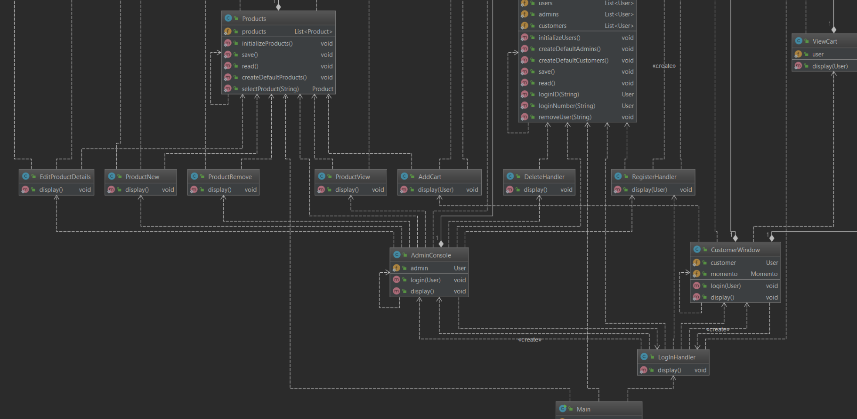
Look at all those classes that display things. Creating functionality is straightforward and things rarely break
When they do break, it’s easy to find where it broke, and it is was usually easy to fix

Slide 6
Memento
Used memento to save and load Customer’s shopping cart
It was a total headache but it works
Implementation was confusing, I’ll admit.

Slide 7
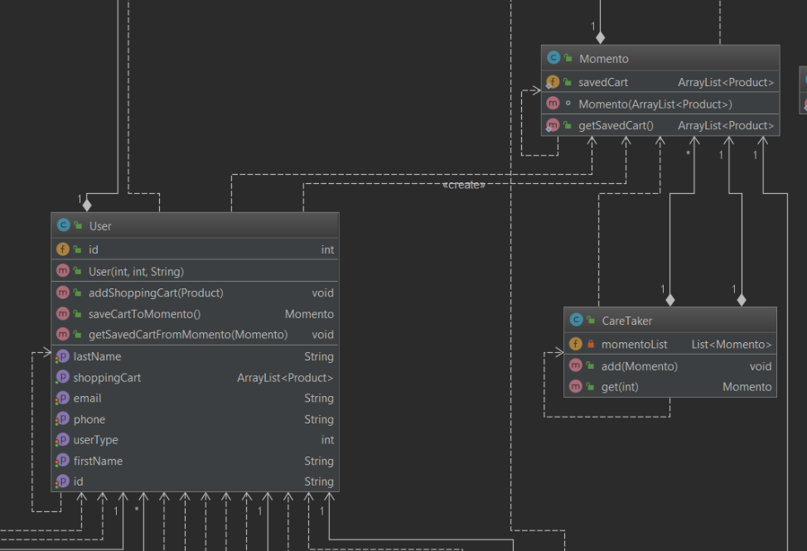

Slide 8
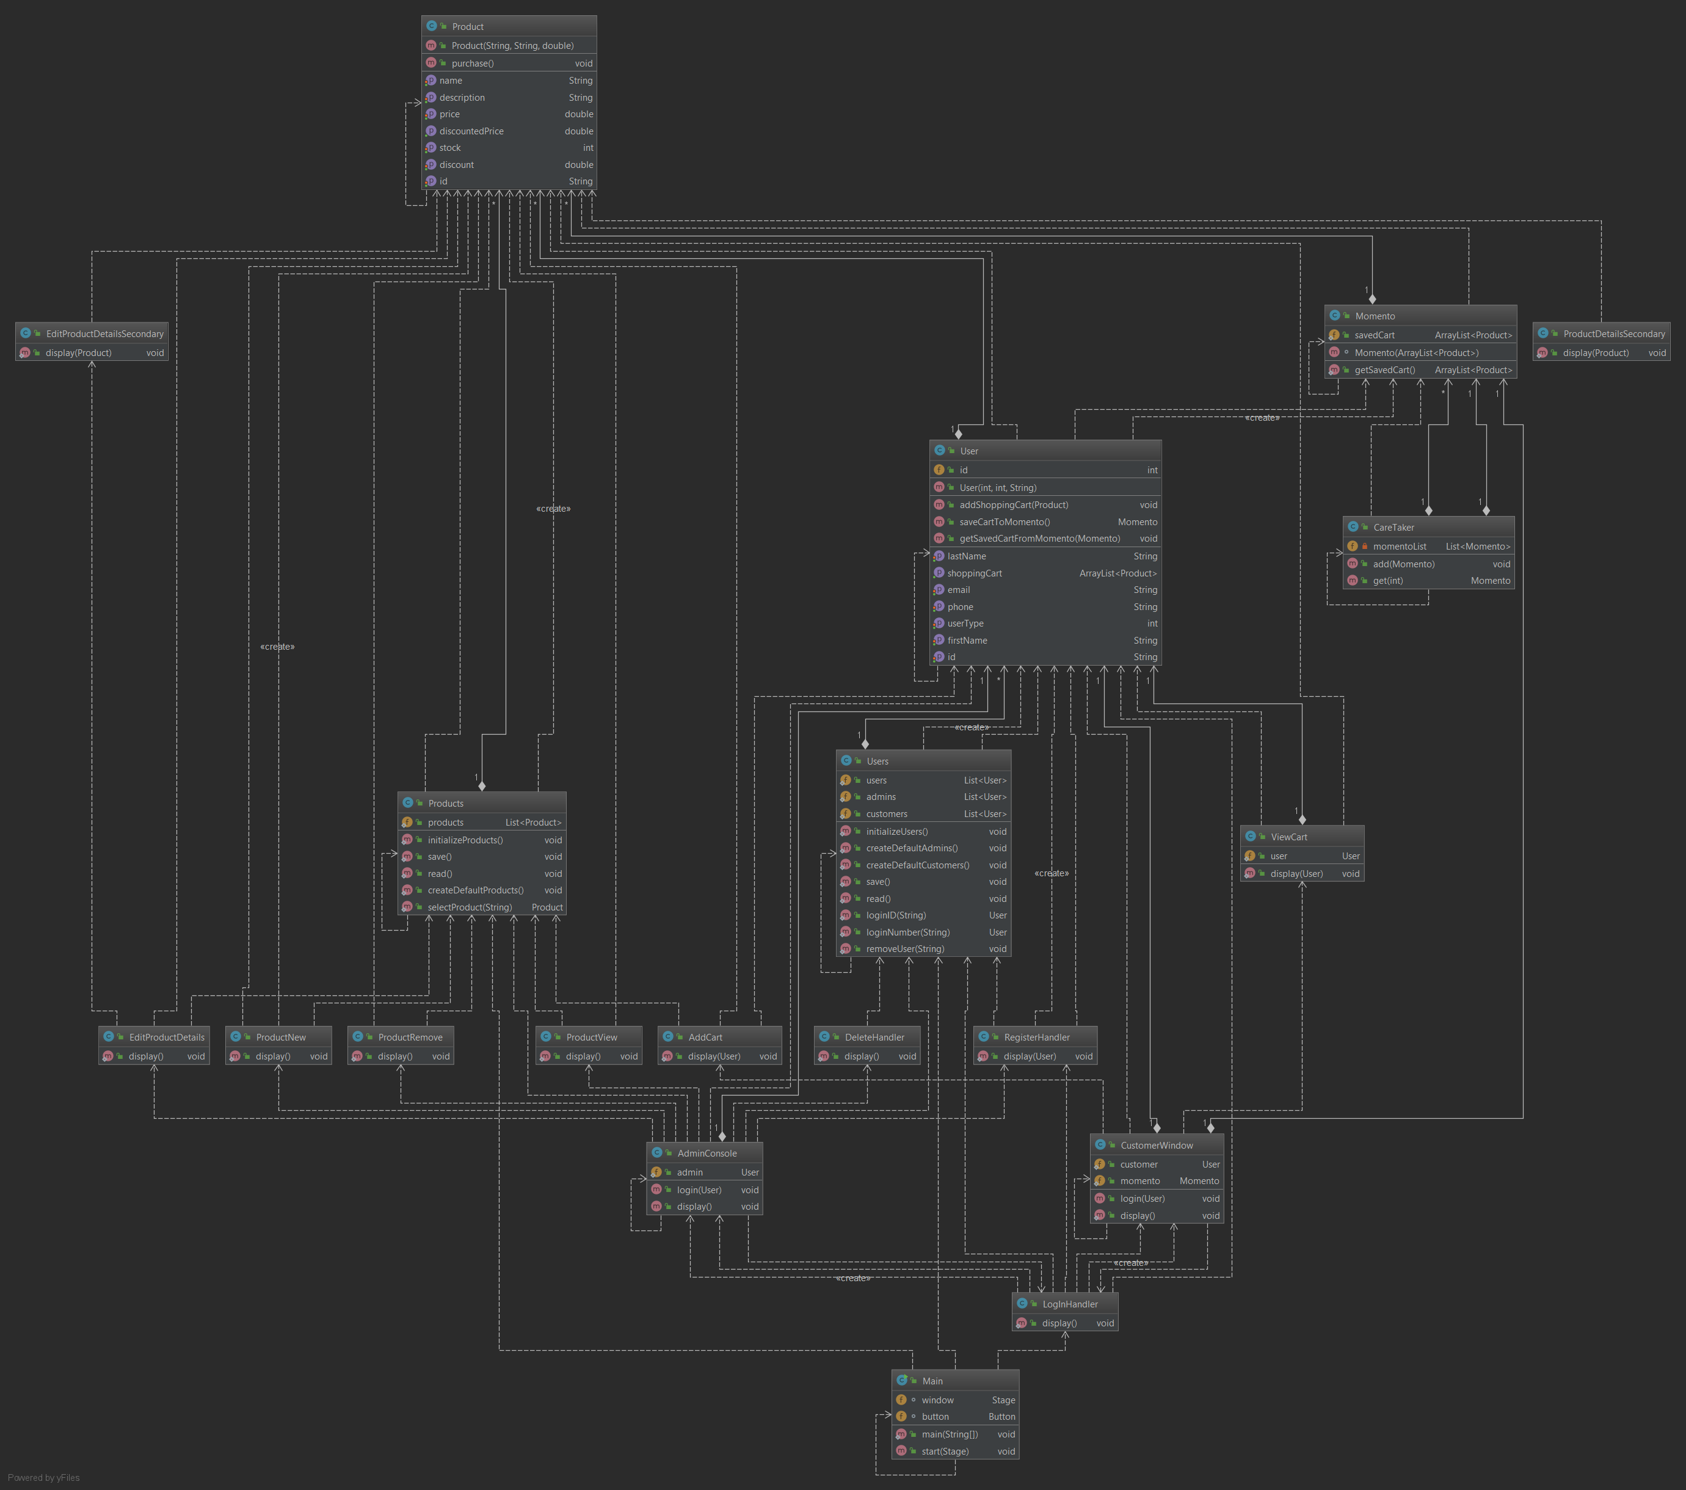
That’s the end of the Powerpoint
Thanks for watching!
And here’s the whole diagram that Intellij generated.
In case you wanted to take a look
It doesn’t say much because it’s so big but it’s cool to look at,
I guess…
Please don’t take off points for this I just wanted some eye-candy on my last slide. I zoomed in for the slides where it was required! :D

